Slide 1
My Orchestra App Usability Study
July 5, 2022
Team
Joe Dundore
Update #1

Slide 2
Table of Contents
Section 1 Study Details
Section 2 Brief Review
Section 3 Themes
Section 4 Insights & Recommendations
Section 5 Additional Research Recommendations

Slide 3
Study Details

Slide 4
Project Background
I’m creating an app that helps students, teachers, and parents learn about, or use as a teaching tool for, the orchestra. Busy parents need ways to help their children at home, and there are currently limited options to do this for orchestra, in the market today.

Slide 5
Study Details
Research Questions
Participants
Methodology
How long does it take for a user to get from the home screen, pick an instrument, and navigate to the listen screen?
What can we learn from the steps users take to reach the listen screen?
How will users navigate to other screens in the app?
How will users find the look, and feel of the app overall?
How long does it take for a user to pick an instrument to learn about shown on the home screen?
5 participants
two males, three females, 18-72 years of age
30 minutes per participant
United States, remote
Unmoderated usability study
Users were asked to perform tasks in a low-fidelity prototype

Slide 6
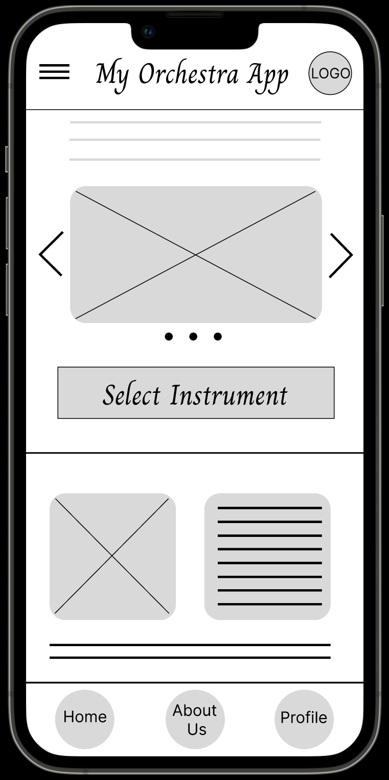
Prototype / Design Tested
To the right is a screenshot of the prototype. Click it to see the actual prototype.

Slide 7
Brief Review

Slide 8
Brief Review (Updated 7/5/22)
In the last presentation, we discussed the insights from the usability study. This presentation shows the updates made since then. Big considerations were the back button needed on some screens, images instead of words when possible, and less confusion for the users by making all pages as intuitive as possible.

Slide 9
Themes

Slide 10
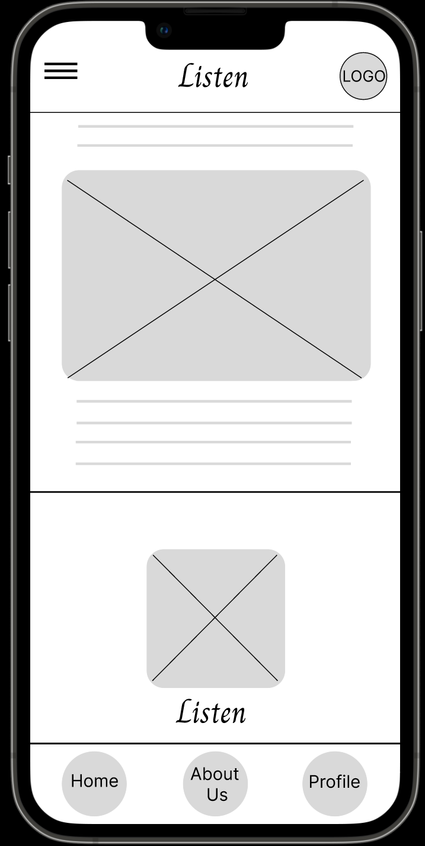
Users Confused
It was observed that 4 out of 5 participants were confused in sections of the navigation process.
This means that navigation in certain areas of the app are difficult for almost all users.
"I will try going back to take the quiz. I don't see a back button. That's weird. Maybe try the home button?"” (PA)
a
There is no back button on this screen.

Slide 11
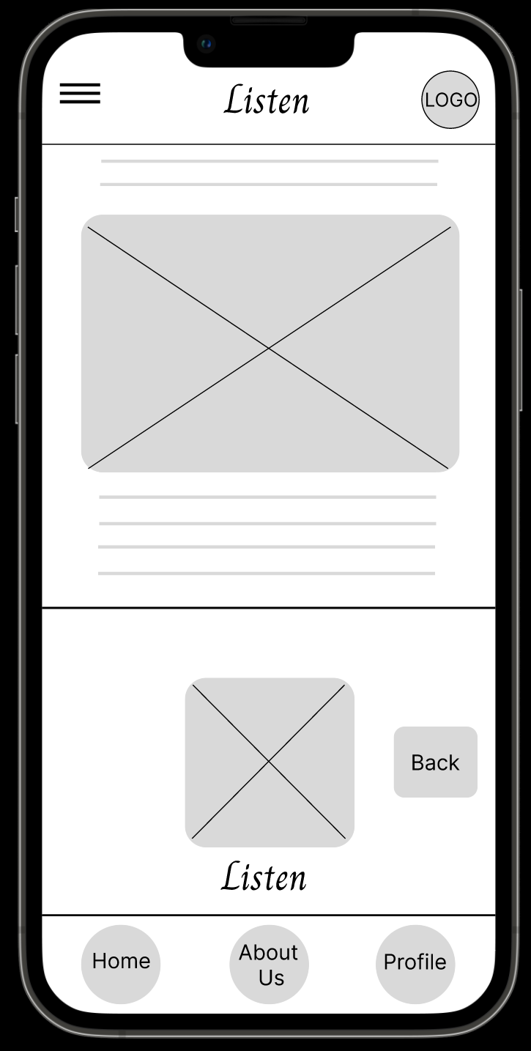
Users Confused (Updated 7/5/22)
It was observed that 4 out of 5 participants were confused in sections of the navigation process.
The most seen problem was going back to the instrument screen from the listening screen. It is now fixed, as seen in the prototype to the right.
There is now a back button on this screen.

Slide 12
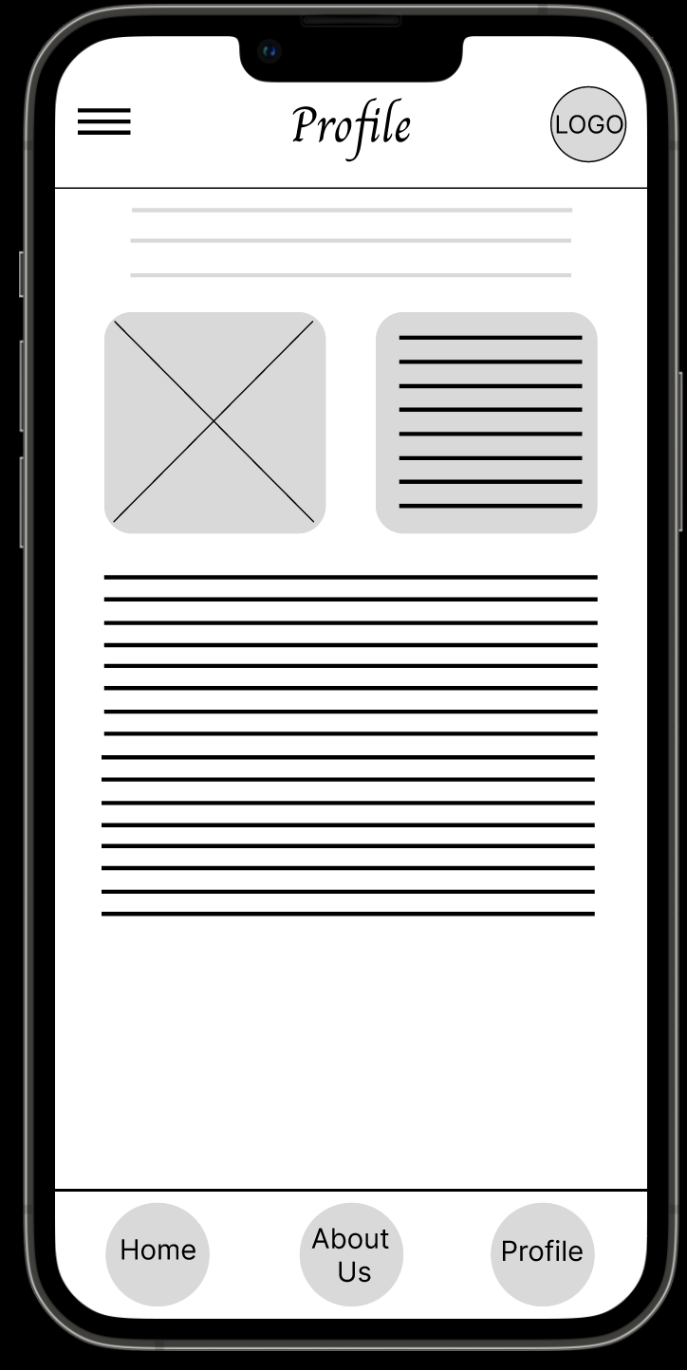
Users Frustrated
It was observed that 3 out of 5 participants were frustrated when using certain sections of the app.
This means that for most users, frustration occurs at some point when using the app.
"I am really confused on how to go back. I don’t see anything labeled. I'll try clicking the home button since all the other buttons don't really make sense. Now it looks like I have to start all over! This is so annoying!" (PE)
Not enough choices. Participant confused on where to go next.

Slide 13
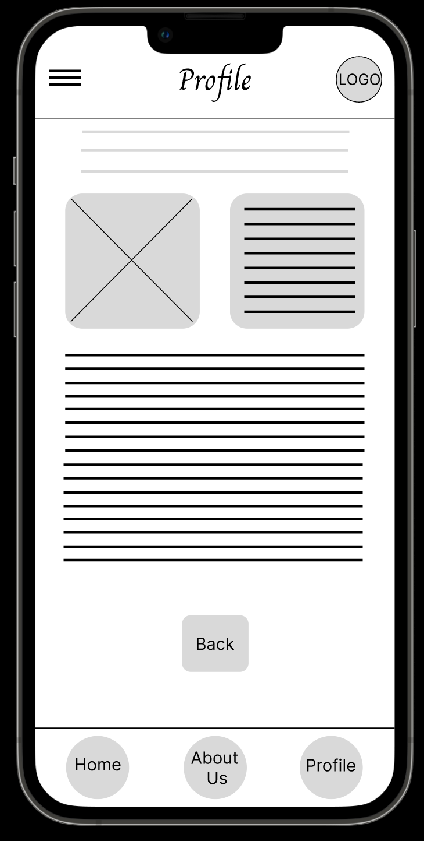
Users Frustrated (Updated 7/5/22)
It was observed that 3 out of 5 participants were frustrated when using certain sections of the app.
Users did not have enough choices to leave certain pages such as the ”Profile” page. We’ve added a back button, as shown on the right.
This button now takes users to the home page.

Slide 14
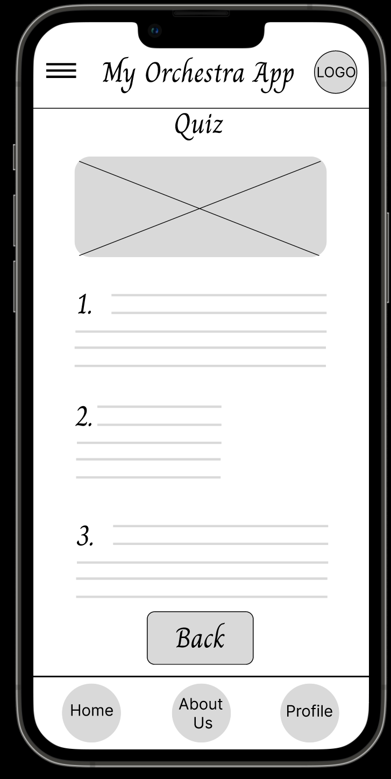
Intuitive App
It was observed that 5 out of 5 participants thought the app was intuitive to navigate in certain areas.
This means that all users found the app intuitive to use in certain areas.
“I'll try the quiz. I see there is a back button on the quiz page.” (PD)
This button makes it easy to go back.

Slide 15
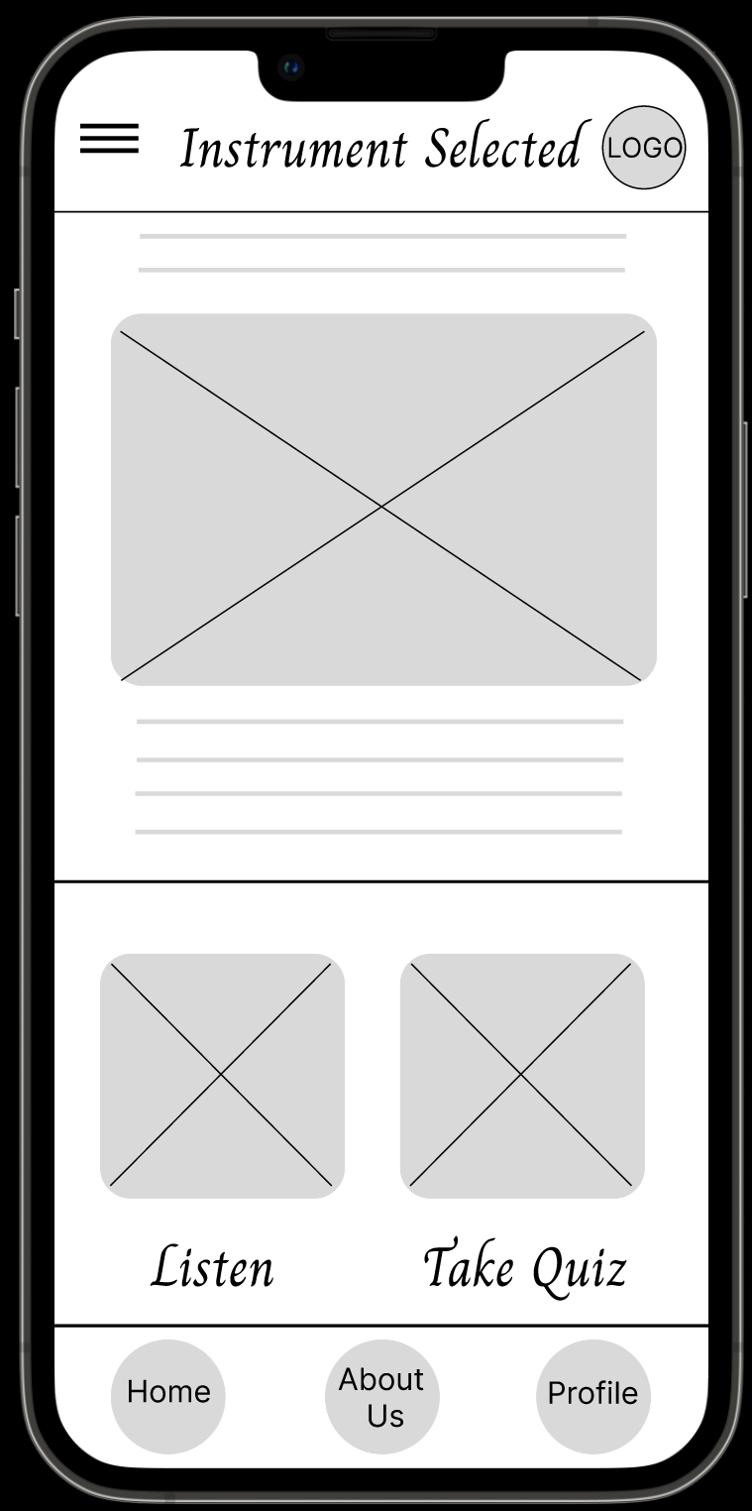
Big Photos and Images
It was observed that 4 out of 5 participants found the app to be easy to understand with the big photos and images.
Almost all users understood how to use much of the app because of the size of the images.
“I don't know if it's intuitive or not, but I like the big images. At least I can see what I am clicking." (PC)
Beautiful photo of instrument selected gives clear understanding of the look of the instrument.
a
Big buttons with appealing images show where the buttons will lead.

Slide 16
Overwhelming Gallery
It was observed that 4 out of 5 participants were overwhelmed when choosing an instrument in the gallery.
This means that choosing an instrument in the gallery is difficult for almost all users.
“There are a lot of instruments in the gallery to choose from, but I'm not sure what the best instrument would be good for a Kindergartner to start with.“ (PB)
This gallery of instruments can be overwhelming.

Slide 17
Overwhelming Gallery (Updated 7/5/22)
It was observed that 4 out of 5 participants were overwhelmed when choosing an instrument in the gallery.
We’ve updated the gallery and removed all instruments except violin, viola, cello, and bass. In the future, we may add a feature so users can experience all instruments of the orchestra.
This gallery is now less overwhelming with fewer instruments.

Slide 18
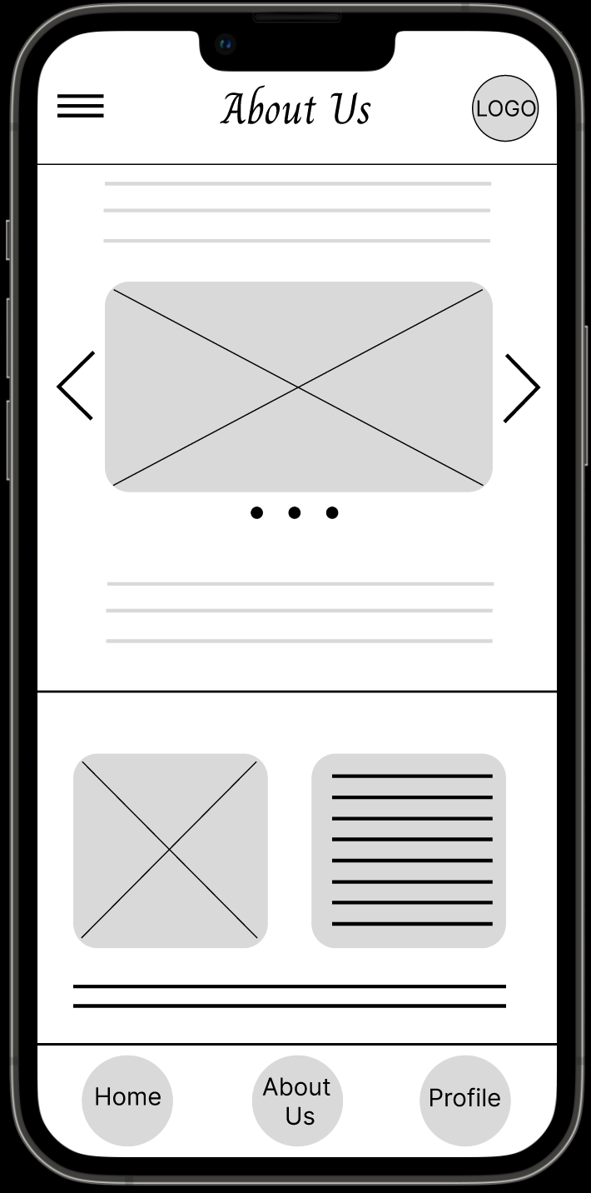
Words Too Small
It was observed that 2 out of 5 participants thought the words were hard to read because of small size font and lack of emphasis.
This means that some users thought the words in the app were hard to read.
“"The words could be bigger on my phone.” (PC)
Words are too small for some users.

Slide 19
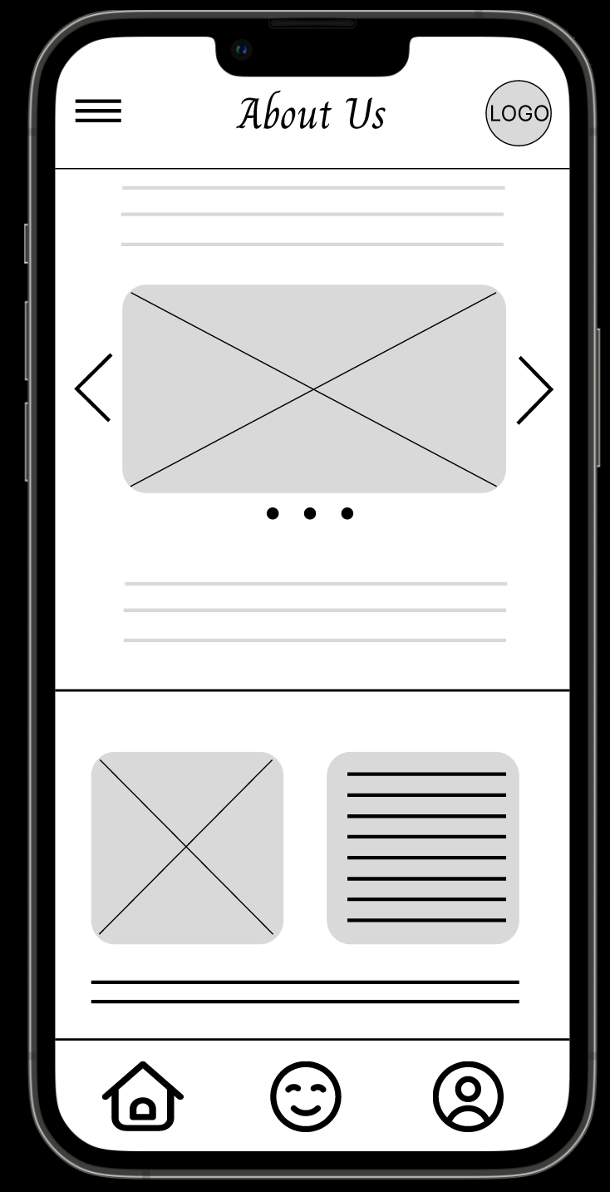
Words Too Small (Updated 7/5/22)
It was observed that 2 out of 5 participants thought the words were hard to read because of small size font and lack of emphasis.
To remedy this, where applicable, we replaced words with images. As shown in the image to the right.
Words replaced with images.

Slide 20
Insights & Recommendations

Slide 21
Research insights (Updated)
Easier Navigation Needed
Overwhelming Gallery
Intuitive App
Words Too Small
Navigation between certain parts of the app need corrected
(update made 7/5/22)
Less instruments in the gallery
(update made 7/5/22)
Continue app intuitiveness throughout
App should be utilized for screen reader, and use images in place of words (when possible)
(update made 7/5/22)

Slide 22
Recommendations
App should be more accessible to all. Add the ability for the use of a screen reader.
Insert a back button onto each page. Preferably a back button in the same location of each page, possibly the header.
Use images in place of words. For example, Home should be an image, not a word. (update made 7/5/22)

Slide 23
Additional Research Recommendations

Slide 24
Additional Research Recommendations (Updated 7/5/22)
Further research into whether users would like more instruments to choose from, or keep the four most prominent orchestra instruments in the app, only.
Further research into whether each screen needs a back button, or is the app still intuitive if only some screens use a back button.

Slide 25
Thank you!

